Slide 1

Pretty Paint
Drawing App for Kids
Members: Ishrat Jahan Ananya 1631636042 Sarah Suad 1632282642
Nahian Noshin Nur 1510798642

Slide 2

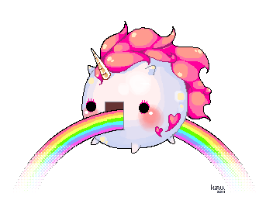
What is Pretty Paint?
Pretty paint is a fun drawing app targeted towards young children.

Slide 3


Target Audience and Objective
Target Audience: This app is mainly targeted toward kids of age 3-6 years.
There are many drawing apps on the market but none of them are clean and simple enough for kids of this age limit.
Now a days little children get attracted to phones very early on as parents use it as a way to distract them. This app is made exactly with that in mind.
Objective: It will act as a educational “distraction” and not only help children enhance their brain development but will also be a source of lots of fun and excitement.

Slide 4
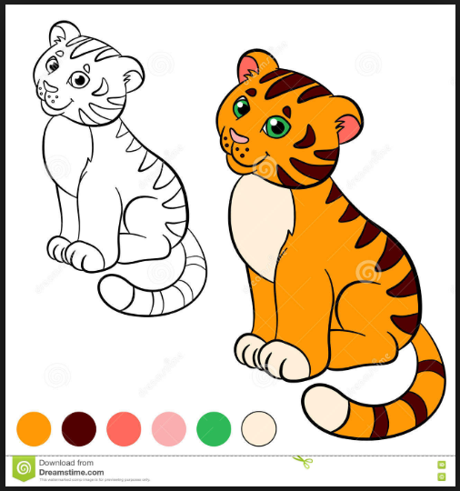
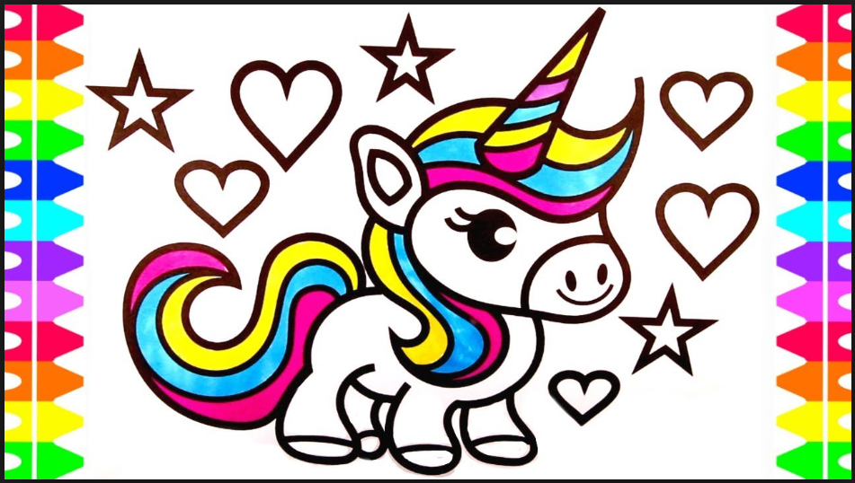
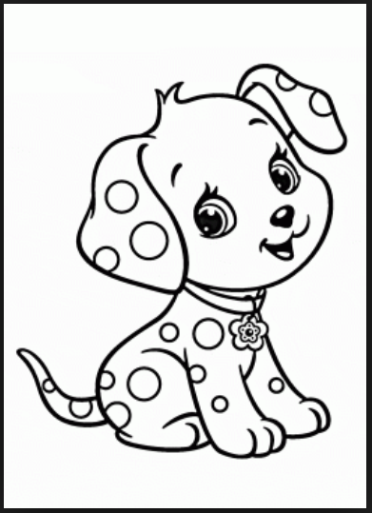
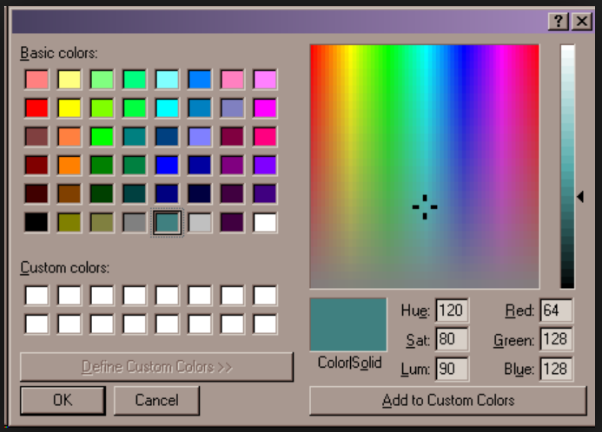
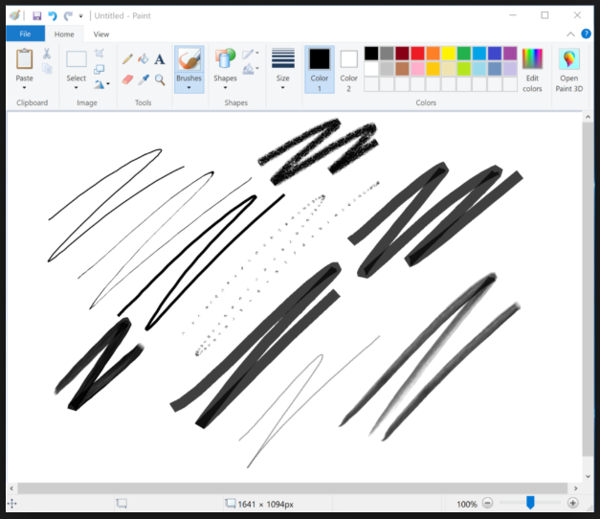
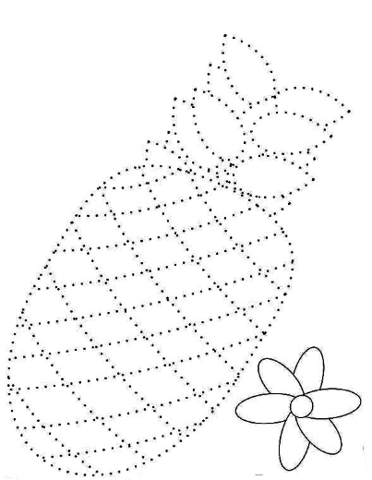
Features
Vibrant colorful graphics
Drawing and coloring tools
Pre-set templates to color
Pre-set templates to edit or draw on
Slate for free hand drawing
Multiple brushes to choose from
Color wheel to select color from
Undo-Redo options
Save-Delete options

Slide 5
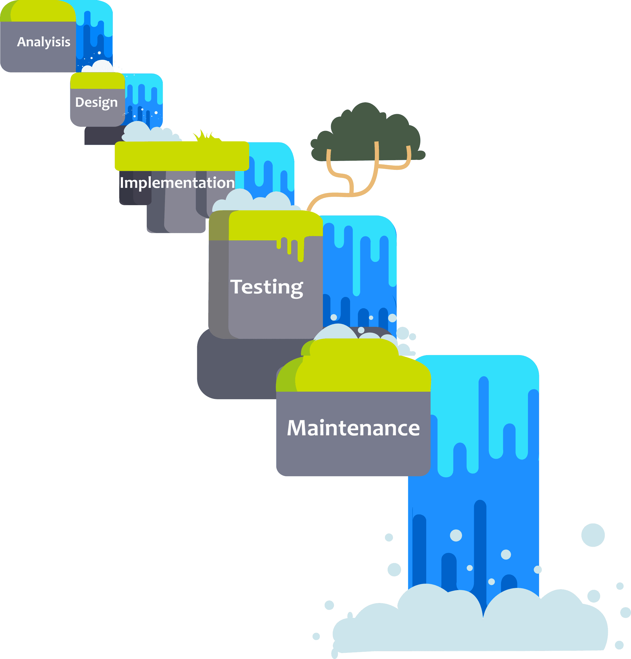
Software Process Model
Model Used: The Waterfall Model
It is the simplest model available. In this model, each phase depends on the phase that comes before it.
We chose this model because our project is very precise, and straightforward. The app development process in this project requires us to depend on the previous phases. This is why the waterfall model is our perfect fit.

Slide 6
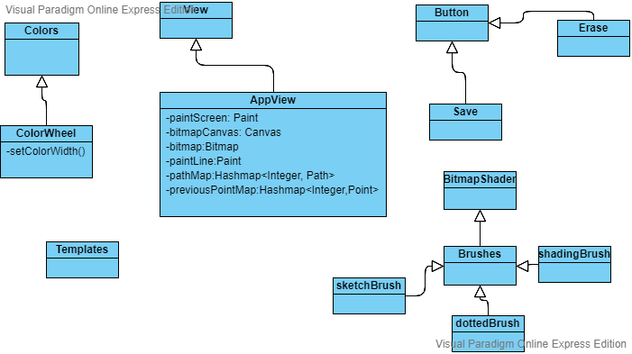
Design

Slide 7
Implementation and Integration

Slide 8
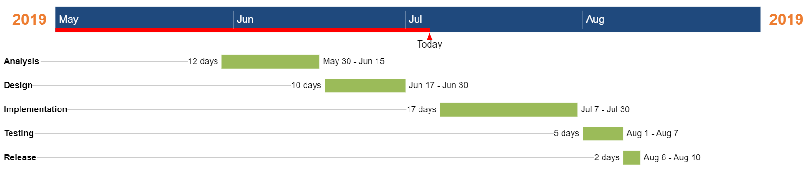
Work Plan - Timeline

Slide 9


